Slide 1
DATA RIDERS Logistic regression.
Presented by:
Santhosh Kumar
Yuvaraj Nachimuthu
Ekta Chaurasia
Avishek Deb
Srinath Ganesh

Slide 2
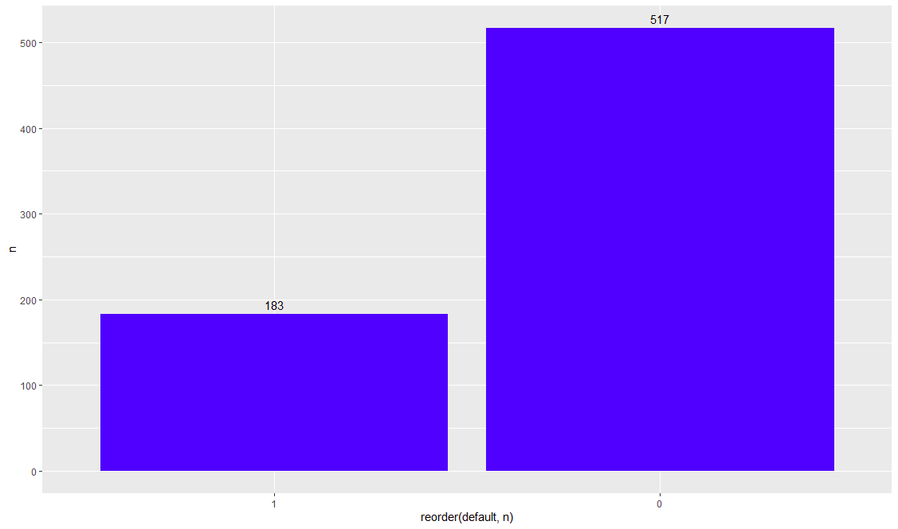
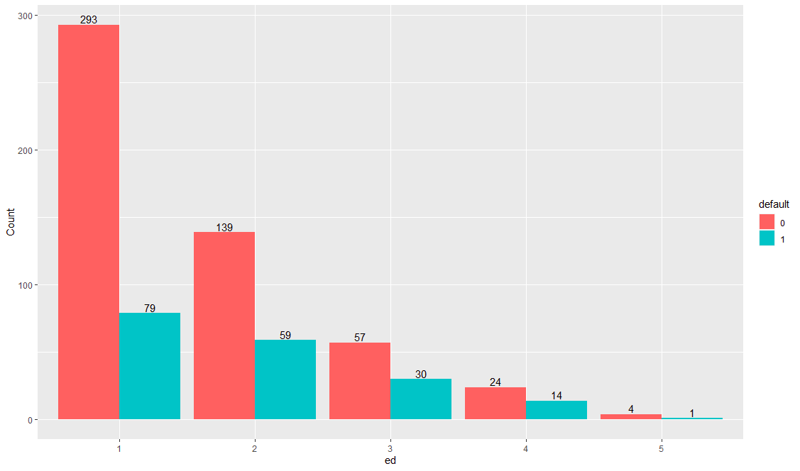
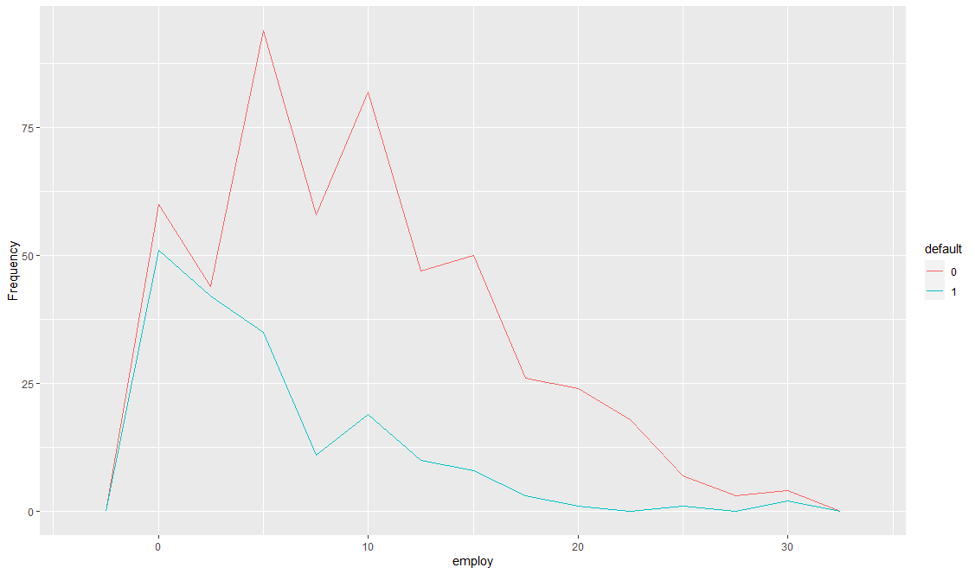
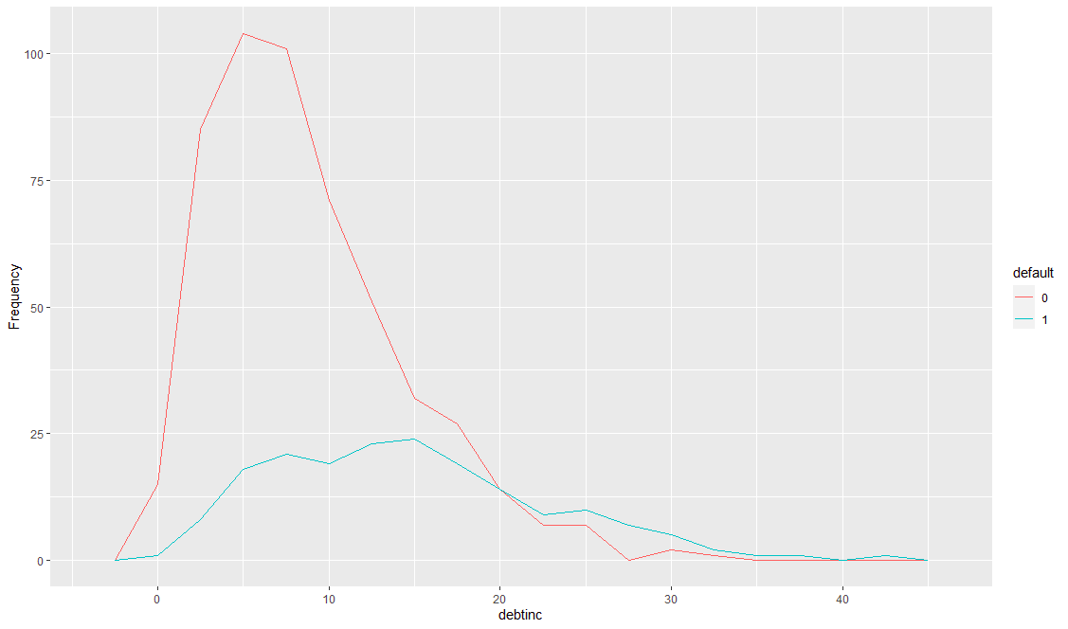
Education
Defaulters
Non-defaulters

Slide 3
Recall vs Precision
 |  | Predicted
 |  | No | Yes
Actual | No | True Negative | False Positive
 | Yes | False Negative | True Positive
You do not want emails from your boss being marked as spam! You need good Precision here.
You do not want potential fraud to be missed out from review! You need good Recall.

Slide 4
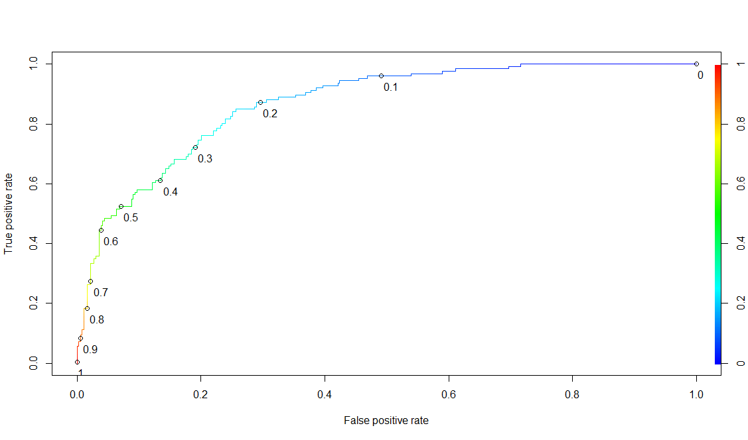
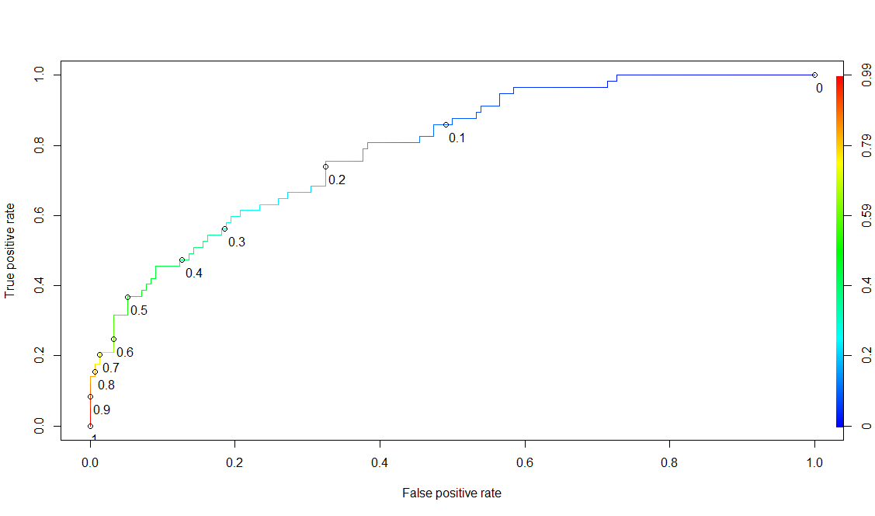
Model 1 : ROC Curve
Train data
Test data

Slide 5
Model 1
Confusion Matrix (Train data) |  | Predicted
 |  | No | Yes
Actual | No | 199 | 164
 | Yes | 5 | 121
5 are Predicted as ND but will default 164 Predicted as defaulter but ND
Confusion Matrix (Test data) |  | Predicted
 |  | No | Yes
Actual | No | 84 | 70
 | Yes | 10 | 47
10 Predicted as ND but will default 70 Predicted as defaulter but ND
Variables | Estimate
Employ | -0.25962
Cred debt | 0.58834
address | -0.1047
debtinc | 0.1166

Slide 6
Model 1: Detailed
 | Train | Test
Accuracy | 65.44 | 76.3
Precision | 42.46 | 40.17
Specificity | 54.82 | 54.55
Sensitivity (Recall) | 96.03 | 82.46
AUC | 88.17 | 79.8

Slide 7

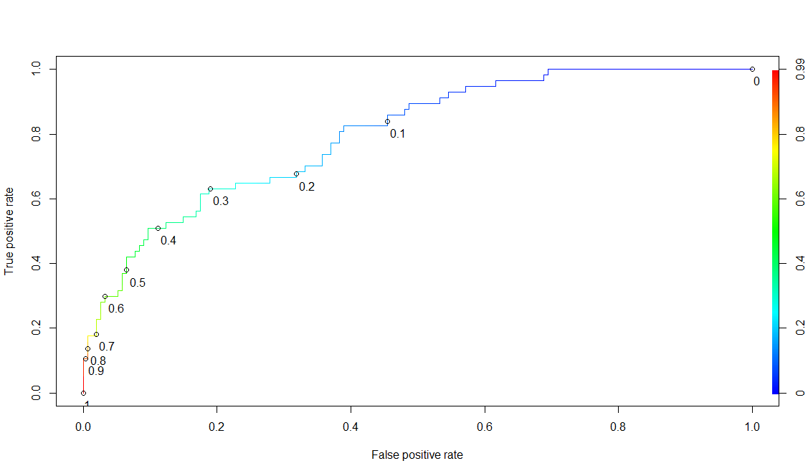
Model 2: ROC Curve
Train data
Test data

Slide 8
Model 2
Confusion Matrix (Train data) |  | Predicted
 |  | No | Yes
Actual | No | 185 | 178
 | Yes | 5 | 121
5 Predicted as ND but will default 178 Predicted as defaulter but ND
Confusion Matrix (Test data) |  | Predicted
 |  | No | Yes
Actual | No | 79 | 75
 | Yes | 8 | 49
8 Predicted as ND but will default 75 Predicted as defaulter but ND
Variables | Estimate
Employ | -0.2576
Cred debt | 0.5042
debtinc | 0.1109

Slide 9
Model 2: Detailed
 | Train | Test
Accuracy | 62.58 | 60.66
Precision | 40.47 | 39.52
Specificity | 50.96 | 51.3
Sensitivity (Recall) | 96.03 | 85.96
AUC | 86.7 | 79.06

Slide 10

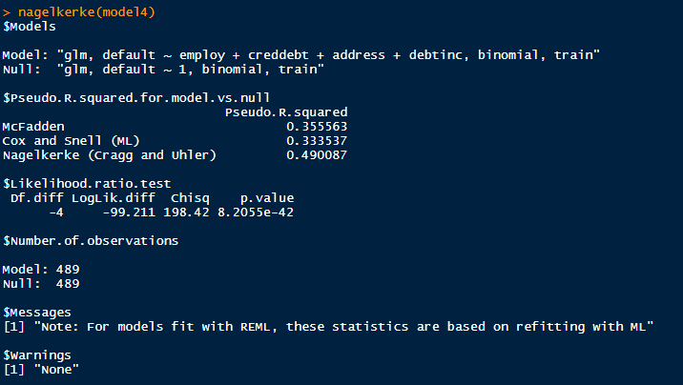

Slide 11
Thank You
Github - https://github.com/srinathganesh1/Data-Riders/tree/master/LogisticRegression
Website - https://datariders.wixsite.com/datarider

